Slide 1



Secure Programming
01
SERVER SIDE
REQUEST FORGERY
Attacks and Mitigations
MEMBER
THY Dayuth
CHO Davon
KOSAL Karuna
Date
Professor :
LAY Leangsros
March 27th, 2026

Slide 2

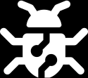


Secure Programming
02
Table Content
INTRODUCTION
HOW SSRF WORKS
CHARACTERISTICS OR COMMON ATTACK PATHS
IMPACT
DEMONSTRATION
PREVENTION / MITIGATION

Slide 3

Secure Programming
03
Introduction / Definition
WHAT IS SSRF?
WHAT IS SSRF?
SSRF (Server-Side Request Forgery) is a vulnerability where an attacker tricks a server into making unintended requests.
Attacker → server → target
The attacker does not access the target directly; the server does it for them.
WHY “SERVER-SIDE”?
WHY IT MATTERS
The request is executed by the backend server, not directly by the attacker.
Internal systems trust requests from the server.
Attackers can access resources they normally cannot.

Slide 4
Secure Programming
04
How SSRF Works
NORMAL REQUEST FLOW
WHERE IS THE VULNERABILITY?
User → Web Application → External Resource (e.g., API, website)
Attacker → server → target
The attacker does not access the target directly; the server does it for them.
MALICIOUS REQUEST FLOW
WHY SERVER BECOMES THE REQUESTER
The request is executed by the backend server, not directly by the attacker.
Internal systems trust requests from the server.
Attackers can access resources they normally cannot.
TRUST BOUNDARY PROBLEM
KEY POINT
Internal systems trust requests from the server.
Attackers can access resources they normally cannot.
SSRF abuses the server’s trust and access to reach hidden resources.

Slide 5


05
Characteristics / Common Attack Paths
Internal network access
01
the server can reach private IPs or internal services.
Cloud metadata access
02
cloud environments may expose sensitive instance information through special internal endpoints.
Bypassing intended restrictions
03
the app may only expect external URLs, but the attacker supplies an internal one.
Different URL schemes
04
some applications fail to restrict what type of resource can be requested.

Slide 6


06
Impact
DATA EXPOSURE
internal files, service responses, or configuration data may be leaked.
UNAUTHORIZED INTERNAL ACCESS
admin panels or internal APIs may be reached.
CREDENTIAL LEAKAGE
secrets or tokens may be exposed.
ATTACK CHAINING
SSRF can be used as a stepping stone for deeper compromise.

Slide 7
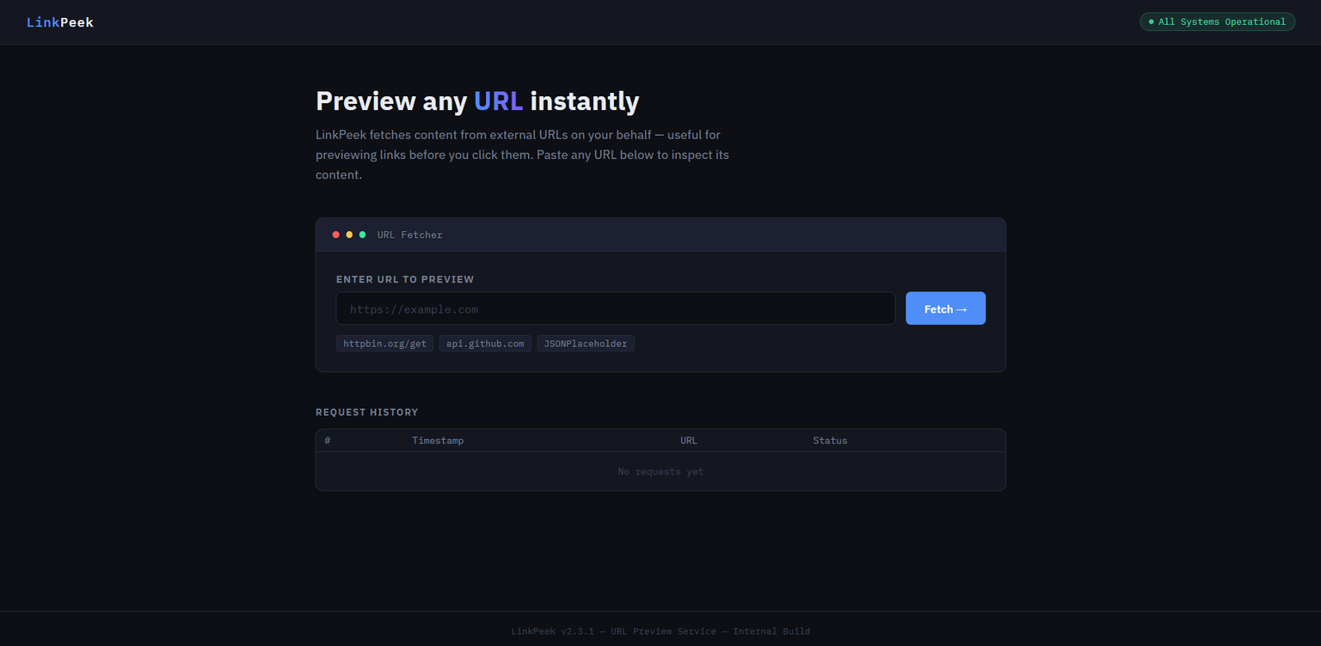
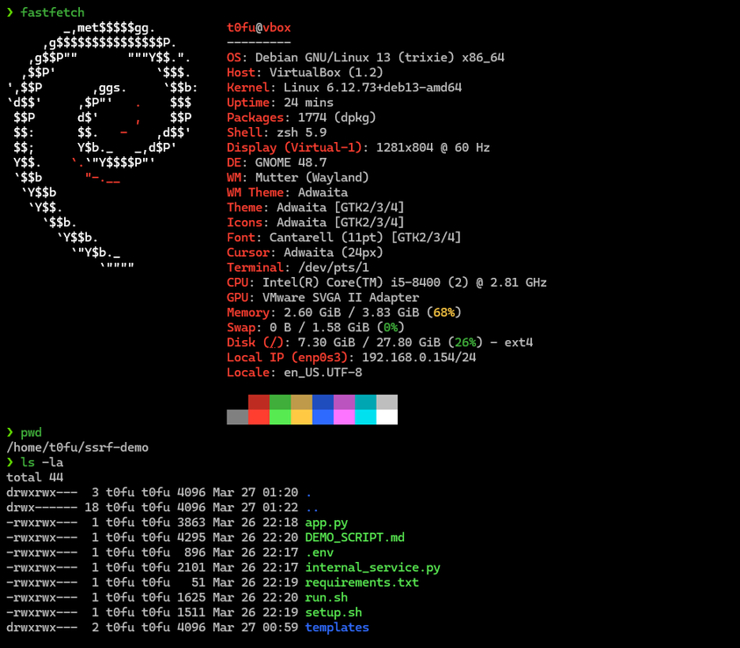
Secure Programming
07
DEMONSTRATION
DEVICES IN USED
WINDOW 11 ( ATTACKER )
DEBIAN ( WEB SERVER )

Slide 8

Secure Programming
08
DEMONSTRATION
NORMAL BEHAVIOR OF THE WEBSITE

Slide 9
Secure Programming
09
DEMONSTRATION
VULNERABLE BEHAVIOR OF THE WEBSITE

Slide 10
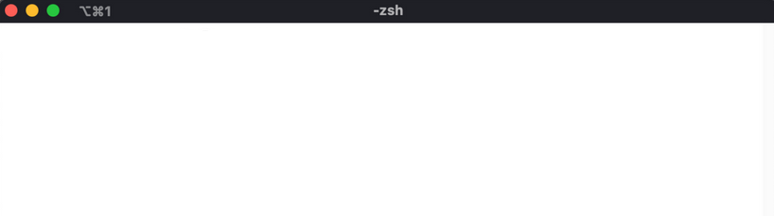
Secure Programming
10
Prevention / Mitigation
Disable unused URL schemes
Security Measure
01
Allow only the schemes the app needs, usually https:// and Block risky schemes like
file://
ftp://
gopher://
dict://
Allowlist + DNS check
04
Only allow approved domains/IPs. Validate and restrict user input to known safe targets.
Validate and sanitize input
http://localhost:8080/admin
http://127.0.0.1:5000/secret http://192.168.1.10/config
02
Never trust user input. Check it strictly and reject unexpected or malicious values.
Authenticate internal services
Safe response handling
03
05
Protect internal services with proper authentication and authorization like
MongoDB (Database)
Elasticsearch (Search & analytics engine)
Memcached (in-memory key-value store)
Do not return raw backend responses. Filter and validate data before sending it to users.

Slide 11
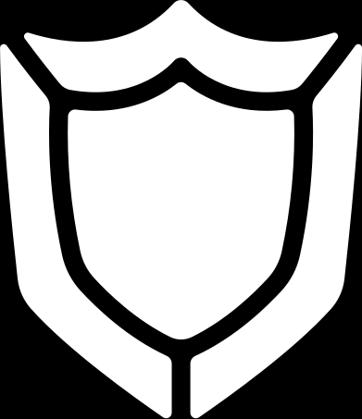
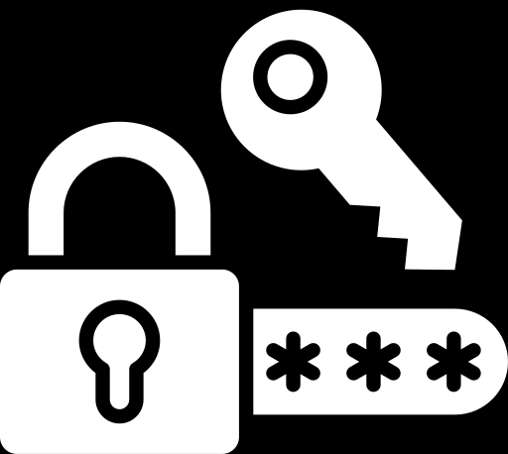
Secure Programming
11
References
OWASP Cheat Sheet ( SSRF Prevention ) : https://cheatsheetseries.owasp.org/cheatsheets/Server_Side_Request_Forgery_Prevention_Cheat_Sheet.html
Veracode : https://info.veracode.com/rs/790-ZKW-291/images/ssrf-prevention-guide-en.pdf
SSRF Bible Cheatsheet : https://cheatsheetseries.owasp.org/assets/Server_Side_Request_Forgery_Prevention_Cheat_Sheet_SSRF_Bible.pdf
A New Era Of SSRF : https://blackhat.com/docs/us-17/thursday/us-17-Tsai-A-New-Era-Of-SSRF-Exploiting-URL-Parser-In-Trending-Programming-Languages.pdf

Slide 12

Secure Programming
12
THANKS YOU
Q & A

